Slide 1
HR Analytics: Employee Retention Prediction

Slide 2
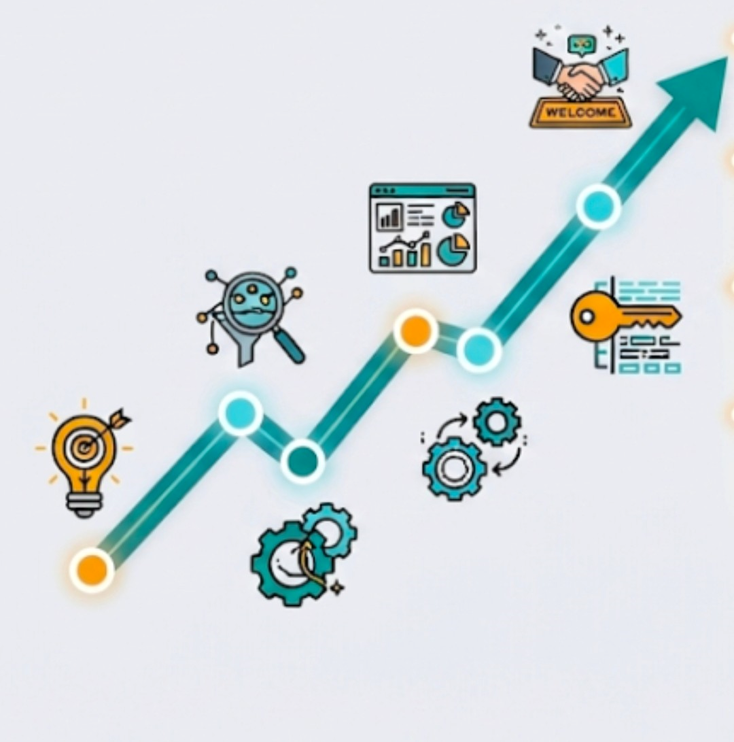
TABLE OF CONTENT :
PATHWAYS TO RETENTION.
A
INTRODUCTION
A
DATA GATHERING AND REFINEMENT
A
EXPLORATORY DATA ANALYSIS
A
FEATURE EXTRACTION
A
METHODOLOGY
A
CONCLUSION

Slide 3




INTRODUCTION
Project Framework & Objective
The Business Challenge
Importance of Retention
High training costs.
Candidates leaving post-training.
Disrupted hiring strategies.
High training costs.
Candidates leaving post-training.
Disrupted hiring strategies.
Role of Predictive Analytics
The Primary Objective
Replaces human intuition.
Uncovers hidden behavior patterns.
Enables unbiased hiring decisions.
Build an ML classification pipeline.
Identify genuine flight risks.
Optimize company training ROI.

Slide 4
OBJECTIVE OF THE STUDY
VALUE OF THE STUDY
Compare Models
Evaluate XGBoost and Random Forest.
Data-Driven HR
Make smarter, predictive hiring choices.
Predict Attrition
Identify candidates likely to leave after training.
Handle Imbalance
Use SMOTE to ensure fair predictions.
Optimize ROI
Ensure resources are invested in long-term employees.
Reduce Costs
Save money by targeting loyal candidates.

Slide 5






PROJECT WORKFLOW
LIFECYCLE
STEP
05
Data Preprocessing
Cleaned missing values, encoded data, and applied SMOTE.
Model Selection
Trained advanced algorithms like XGBoost, LightGBM, and Random Forest.
STEP
03
STEP
01
STEP
06
STEP
04
Data Gathering
Extracted over 19,000 HR candidate records with 14 unique features.
STEP
02
Final Evaluation
Benchmarked models based on Accuracy, Precision, and highest Recall.
Train / Test Split
Divided the dataset into a strict 80% training and 20% testing split.
Exploratory Data Analysis
Identified key demographic trends and continuous feature correlations.

Slide 6




DATA COLLECTION & REFINEMENT
1. Dataset Scale
2. Feature Breakdown
3. Target Variable
• Extracted from a robust HR Analytics database.
• The dataset contains 19,158 unique candidate records.
• It features 14 distinct columns capturing detailed backgrounds.
• Demographic: City Dev Index, Gender, Edu Level, Major.
• Experience: Relevant Experience, Company Size/Type.
• Continuous: Total Training Hours completed.
• Primary target variable is labeled as 'target'.
• 0 (Not Looking): Candidate is loyal and will stay.
• 1 (Looking for Job): Candidate is actively seeking a change.

Slide 7
DATA DICTIONARY: VARIABLES
enrollee_id: Unique candidate ID.
major_discipline: Educational major.
city: Candidate's city code.
experience: Total years of experience.
city_development_index: Scaled development index of the city.
company_size: Size of current employer.
gender: Candidate's gender.
company_type: Type of current employer.
relevent_experience: Professional experience status.
last_new_job: Years since previous job.
enrolled_university: Type of university course enrolled.
training_hours: Total training hours completed.
education_level: Highest education achieved.
target: 0 = Stay. 1 = Looking for job change.

Slide 8
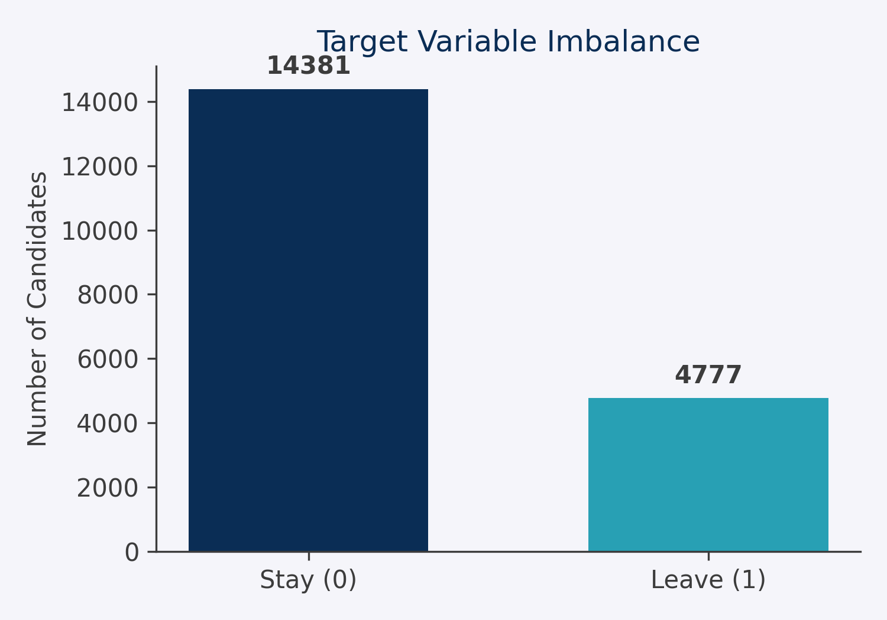
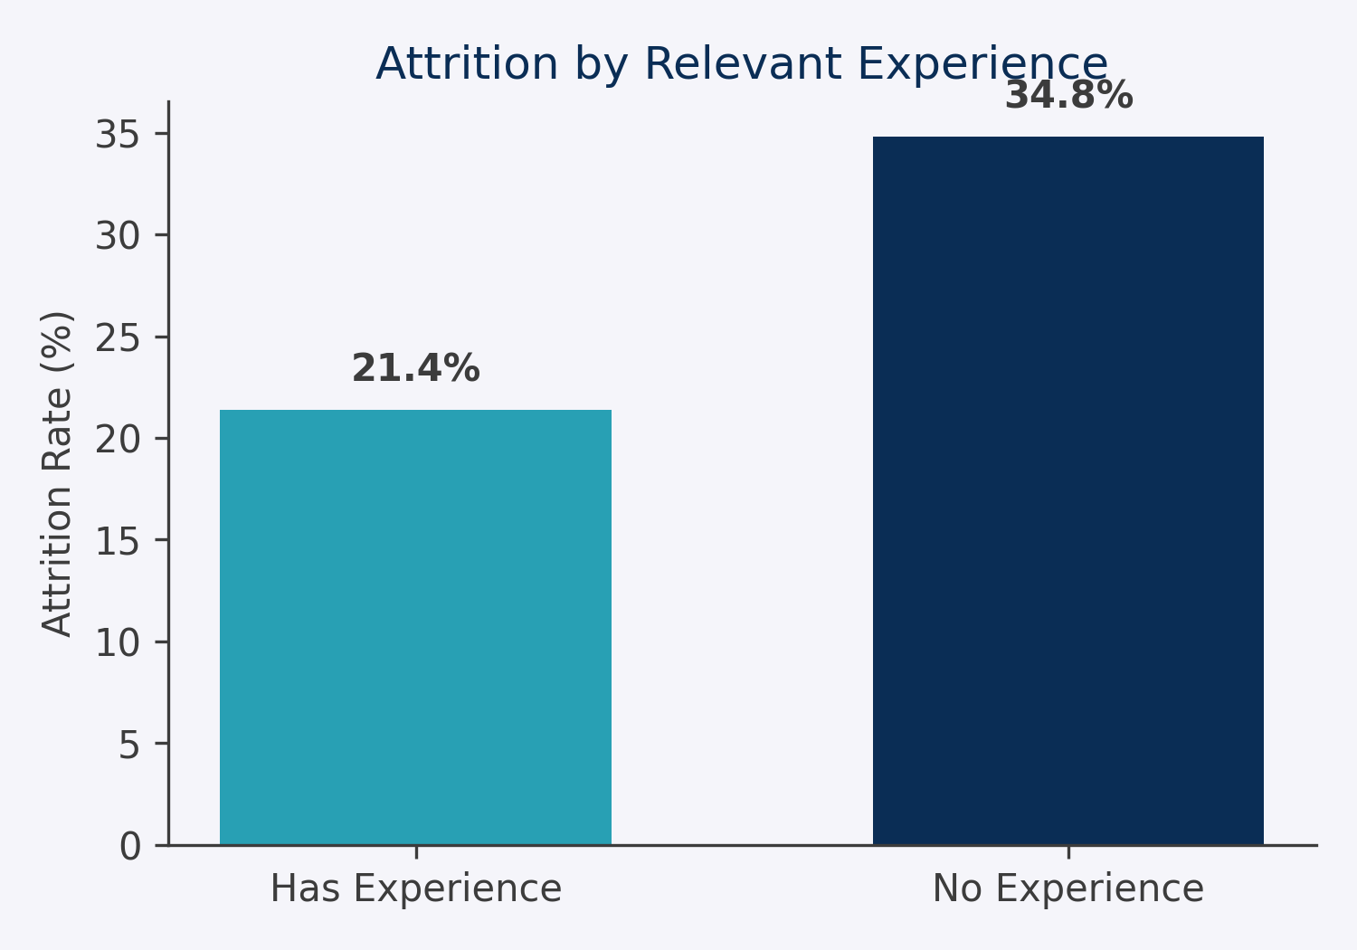
EXPLORATORY DATA ANALYSIS (EDA)
KEY INSIGHT 1: Highly Imbalanced Data
• The target variable is severely imbalanced.
• Only ~25% of candidates in the dataset are actively looking to change jobs (Attrition).
• This proves we must use SMOTE (Synthetic Minority Over-sampling) before modeling to prevent bias.
KEY INSIGHT 2: Experience is a Major Factor
• Candidates lacking 'Relevant Experience' have a significantly higher attrition rate (34.8%).
• Those with relevant experience are much more likely to stay loyal to the company.
• This is a massive indicator for HR when screening new resumes.

Slide 9
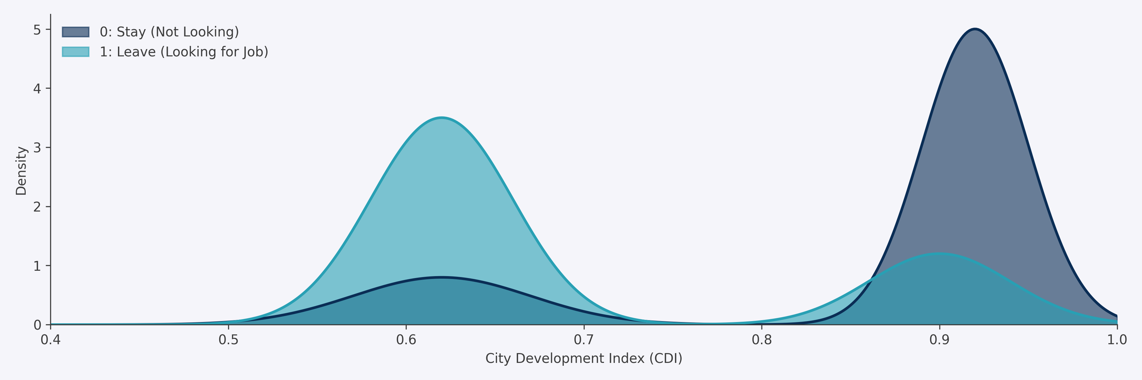
DISTRIBUTION OF CONTINUOUS VARIABLE
Highly Developed Cities
Developing Cities
Key Takeaway
Spike in Loyalty
Spike in Attrition
Crucial ML Predictor
Candidates in cities with CDI > 0.9 are highly unlikely to leave.
A massive surge in attrition exists precisely at a CDI of ~0.62.
This clear bimodal split makes CDI one of the strongest model inputs.

Slide 10
DISTRIBUTION OF CATEGORICAL VARIABLE
Insight: Education Dominance
Insight: Startup vs Enterprise
A massive 60% of the dataset consists of university 'Graduates', meaning our model will naturally be highly biased towards predicting behaviors for bachelor-degree holders.
The most common company size is '50-99' (mid-size startups), followed closely by '100-500'. Very large enterprises (10,000+) only make up a smaller portion of the candidates.

Slide 11
DATA QUALITY: MISSING VALUES
Action Required: Imputation
The dataset has a significant amount of missing values, particularly in 'Company Type' and 'Company Size' (over 30%).
To prepare this data for Machine Learning, we MUST perform Data Preprocessing and Imputation in the next phase.

Slide 12

PREPROCESSING
❑ Missing Value Treatment: Imputed missing values for categorical features like 'Company Size' and 'Gender' using mode/median strategies to ensure zero data loss before training.
❑ Handling Class Imbalance: Applied SMOTE (Synthetic Minority Over-sampling Technique) exclusively to the training set. This perfectly balanced the rare 'Leave' class while strictly preventing data leakage.
❑ Categorical Feature Encoding: Applied One-Hot Encoding and Label Encoding to convert all nominal text variables (e.g., Major, Company Type) into machine-readable numeric formats.
❑ Feature Scaling: Applied StandardScaler to continuous features (like Training Hours) to normalize magnitudes, ensuring algorithms operate without bias.

Slide 13
DATA ARCHITECTURE & SPLITTING
Phase 1: Feature Extraction (X & y)
Phase 2: Strategic 80/20 Validation Split
❑ We mathematically divided the dataset into two distinct tensors: X and y.
❑ 'X' represents the Independent Variables (the candidate's profile: experience, city, education, etc.).
❑ 'y' represents the Dependent Target Variable (whether they want to leave the company or stay).
❑ This explicit separation allows the ML models to map X features to y probabilities.
❑ We split the data into Training (80%) and Validation (20%) sets BEFORE applying any sampling techniques.
❑ Crucially, we applied a Stratified Split to maintain the exact 25% Attrition ratio in both sets.
❑ By isolating the Validation set prior to SMOTE, we absolutely guarantee zero data leakage, ensuring real-world performance metrics.

Slide 14
MODEL SELECTION STRATEGY
Logistic Regression
Random Forest
The Baseline Benchmark
The Robust Ensemble
Selected as our baseline model. It provides a simple, highly interpretable benchmark for attrition probability to evaluate if advanced tree-based models are truly necessary.
Selected because this bagging ensemble method is highly robust to outliers and perfectly handles non-linear relationships within our complex HR categorical data.
XGBoost
LightGBM
The Powerhouse Performer
The Efficient Booster
Selected for its raw predictive power. This gradient boosting framework is famously effective at identifying complex patterns in highly imbalanced datasets like ours.
Selected because it is incredibly memory-efficient, extremely fast, and natively handles complex categorical features without needing excessive One-Hot Encoding.

Slide 15
MACHINE LEARNING RESULTS
Why Accuracy is Misleading
🏆 ULTIMATE WINNER: LIGHTGBM
Because 75% of employees in the dataset stay, a 'dummy model' that always predicts 'Stay' would get 75% Accuracy. Therefore, Recall and F1-Score are the only valid metrics for catching Attrition.
LightGBM proved to be the ultimate model! It achieved ~80% Accuracy while maintaining a massive F1-Score and Recall, successfully identifying the most at-risk employees. It also trained incredibly fast on our categorical data!

Slide 16

Conclusion
KEY FINDINGS
The results indicated that the LightGBM model was the ultimate winner, achieving ~80% Accuracy with massive Recall.
The study utilized the HR Analytics dataset containing 19,158 candidate instances, with all preprocessing and algorithms implemented in Jupyter Notebook.
All ensemble algorithms (Random Forest, XGBoost, LightGBM) significantly outperformed the baseline Logistic Regression model.
LIMITATIONS
Imbalanced Dataset Limitation: Despite using SMOTE to generate synthetic data, the original target variable was highly skewed (75% vs 25%).
Limited Variable Consideration: The analysis relies heavily on demographic and educational variables, overlooking behavioral or psychometric factors.
Lack of Test Dataset Evaluation: We relied on a validation split; true real-world applicability requires testing on a completely unseen holdout dataset.
FUTURE RESEARCH
Future research must ensure robustness and generalizability by gathering more comprehensive data on employee engagement metrics. It's important to evaluate how real-time performance data affects the model's predictive accuracy.

Slide 17
Questions ?

Slide 18
Thank You!

